Slide 1

Superstore Sales, Profit, and Customer Lifetime Value (CLV) Analysis Report
Ayeni Joshua Adaviriku

Slide 2
Introduction
Understanding sales performance, customer value, and profit drivers is crucial for any business aiming to stay competitive. This analysis was carried out to analyze sales data from a fictional Superstore, providing data-driven insights to support marketing, sales strategy, and customer relationship management
Ayeni Joshua Adaviriku

Slide 3
Project Overview
This project involves the development of an interactive Power BI dashboard to analyze sales performance, profitability, and customer lifetime value (CLV) using the Superstore dataset. The dashboard provides stakeholders with a visual representation of key metrics, facilitating data-driven decisions to optimize business operations.
Objectives
Sales and Profit Analysis: Evaluate sales and profit trends across different time periods, regions, and customer segments.
Product Performance Evaluation: Identify top-performing and underperforming product categories and sub-categories.
Discount Impact Assessment: Analyze the effect of discount strategies on profit margins.
Customer Lifetime Value Estimation: Calculate and visualize CLV to understand customer profitability over time.
Interactive Data Exploration: Enable users to drill down into specific data points for in-depth analysis.
Ayeni Joshua Adaviriku

Slide 4
Data Source
The analysis is based on the "Sample - Superstore" dataset, a widely used sample dataset provided by Tableau. It contains fictional retail data of a global superstore over a four-year period. The dataset can be accessed here: Sample - Superstore.xls.
Dataset Description
The dataset comprises 9,994 records and 21 columns, each representing various aspects of the superstore's operations
Tools Used
Microsoft Excel: For initial data exploration and cleaning.
Power BI: For data visualization and dashboard creation.
DAX (Data Analysis Expressions): For creating custom calculations and measures within Power BI.
Ayeni Joshua Adaviriku

Slide 5
Data Preparation and Cleaning
Data Import: Dataset was first loaded to Microsoft Excel for cleaning and preprocessing before being loaded into Power BI for DAX and dashboard creation.
Data Type Adjustment: Ensured correct data types for each column (e.g., dates for date fields, numeric for sales and profit).
Handling Missing Values: Identified and addressed any missing or null values to maintain data integrity.
Duplicate Removal: Checked for and removed any duplicate records to prevent data redundancy.
Calculated Columns: Created new columns to aid analysis, such as:
Year: Extracted from the Order Date.
Month: Extracted from the Order Date.
Customer Lifetime Value (CLV): Calculated based on sales data per customer.
Ayeni Joshua Adaviriku

Slide 6
Exploratory Data Analysis (EDA)
Exploratory Data Analysis was conducted to uncover patterns and relationships within the data. Key analyses included:
1. Sales and Profit Trends Over Time:
2. Sales by Region:
Insight: Recognition of high-performing regions and potential areas for growth.
Insight: Identification of peak sales periods and seasonal trends.
Ayeni Joshua Adaviriku

Slide 7
3. Sales and Profit by Product Category and Sub-Category Performance:
4. Discount Impact on Profitability:
Insight: Understanding how discount strategies affect overall profitability.
Insight: Identification of top-selling products and those with declining sales.
Ayeni Joshua Adaviriku

Slide 8
5. Customer Segmentation Analysis:
KPI Development
Key Performance Indicators (KPIs) were developed to monitor business performance:
Total Sales: Sum of all sales transactions.
Total Profit: Sum of all profit from sales.
Average Discount: Mean discount applied across all orders.
Profit Margin: Ratio of profit to sales, indicating profitability.
Customer Lifetime Value (CLV): Average revenue generated from a customer over their entire relationship with the company.
Insight: Determination of which customer segments contribute most to sales and profit.
Ayeni Joshua Adaviriku

Slide 9
Dashboard Explanation
The Power BI dashboard is structured into several interactive sections:
1. Overview Page:
Displays top-level KPIs: Total Sales, Total Profit, Average Discount, Profit Margin.
Provides a snapshot of overall business performance.
2. Sales Analysis:
Line charts showing sales and profit trends over time.
Filters to view data by year, quarter, or month.
3. Regional Analysis:
Bar chart which gives the ability to drill down into specific sub-category
4. Product Performance:
Bar charts comparing sales and profit across categories and sub-categories.
Identification of best and worst-performing products.
5. Customer Analysis:
Pie charts and bar graphs illustrating customer segments and their contribution to sales.
CLV metrics to assess customer value over time.
6. Discount Analysis:
Scatter plots analyzing the impact of discounts on profit margins.
Insights into optimal discount strategies.
Download Dashboard
Ayeni Joshua Adaviriku

Slide 10
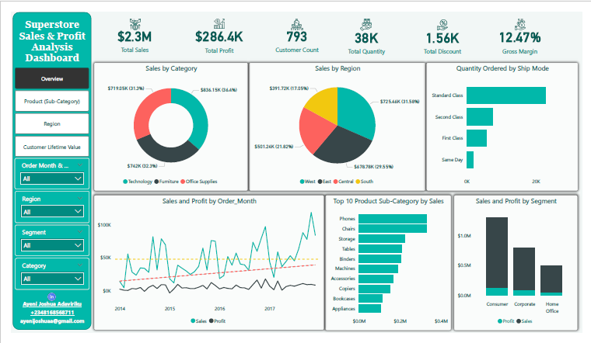
Dashboard (Overview)
Ayeni Joshua Adaviriku

Slide 11
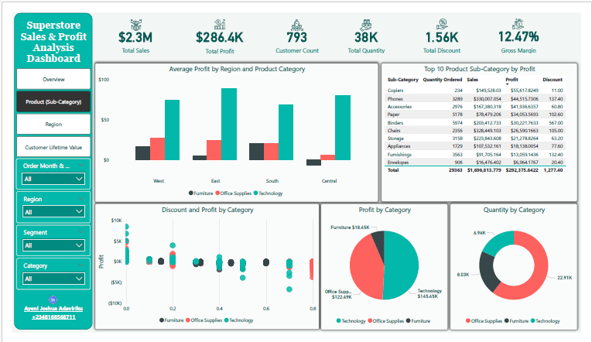
Dashboard (Product – SubCategory)
Ayeni Joshua Adaviriku

Slide 12
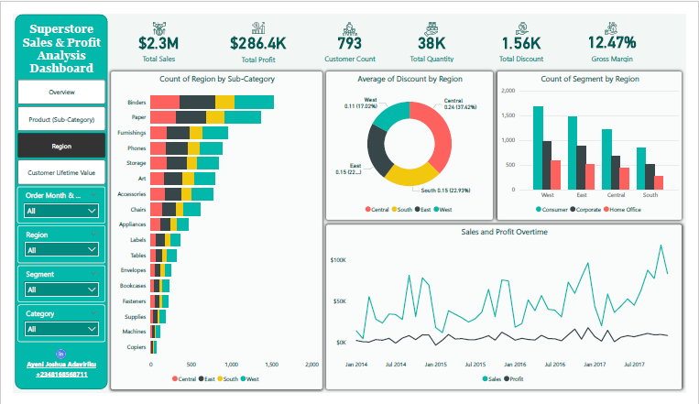
Dashboard (Region Analysis)
Ayeni Joshua Adaviriku

Slide 13
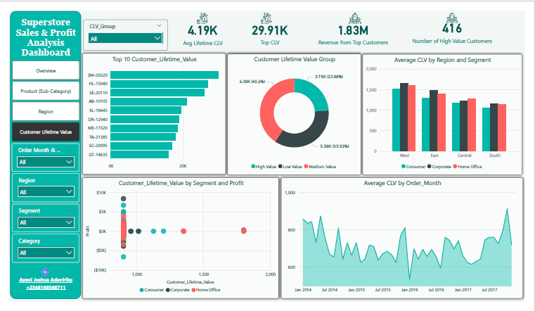
Dashboard (Customer Lifetime Value)
Ayeni Joshua Adaviriku

Slide 14
Insight Summary
Seasonal Sales Trends: Notable increase in sales during the end-of-year period, suggesting a holiday sales boost.
Regional Performance: The Western region outperforms others in both sales and profit, indicating a strong market presence.
Product Insights: Office Supplies category leads in sales volume, but Technology products yield higher profit margins.
Discount Strategy: Excessive discounts are correlated with reduced profit margins, highlighting the need for balanced discounting.
Customer Segments: Corporate and Consumer segments are the primary revenue drivers, with Home Office segment showing potential for growth.
Ayeni Joshua Adaviriku

Slide 15
Recommendations
Based on the insights gathered from the dashboard and exploratory data analysis, the following actions are recommended to improve business performance, optimize operations, and drive customer value:
1. Optimize Discounting Strategy
The analysis revealed a clear negative correlation between high discounts and profitability, especially in the Furniture and Office Supplies categories.
Implement dynamic discounting models that only trigger when needed (e.g., to move slow inventory or retain high-CLV customers).
Evaluate the ROI of discount campaigns regularly to ensure discounts are driving profit, not just sales.
2. Invest in High-Performing Categories
Technology products consistently generated the highest profits with fewer discounts applied.
Allocate more marketing and inventory budgets to Technology and high-margin sub-categories such as Phones, Copiers, and Accessories.
Consider bundling underperforming products with top-sellers to improve overall category performance.
3. Strengthen Regional Strategies
The West region leads in both sales and profit—analyzing operational practices in this region can provide a blueprint for improving performance in lower-performing regions like the South and Central.
Tailor regional marketing strategies based on localized insights (e.g., promotions, top-selling sub-categories per state).
Ayeni Joshua Adaviriku

Slide 16
Recommendations cont’d
4. Leverage CLV Insights for Customer Retention
Introduce loyalty or retention programs targeting high-CLV customers, who generate consistent revenue over time.
Focus customer service and upsell efforts on top-tier customers as identified in the CLV analysis.
For low-CLV customers, investigate engagement strategies like tailored promotions or win-back campaigns.
5. Improve Seasonal Planning
Q4 repeatedly shows peak sales activity—likely influenced by Black Friday, holiday shopping, and end-of-year budget spending.
Plan inventory, staffing, and marketing campaigns to align with seasonal demand, particularly from October to December.
Run seasonal offers with careful monitoring of discounts and profit margins.
6. Enhance Product Portfolio Management
Regularly review underperforming products (e.g., Tables, Bookcases) for pricing updates, product improvements, or promotional efforts.
Phase out products with persistent losses unless strategic value exists (e.g., loss-leaders or bundled products).
7. Adopt Predictive Analytics
Incorporate predictive models to forecast demand, CLV progression, and churn probability.
Use these models to identify customers at risk of leaving and trigger proactive engagement strategies.
Ayeni Joshua Adaviriku

Slide 17
Conclusion
The Superstore Sales and Profit Analysis Dashboard serves as a comprehensive, interactive tool for understanding business performance across multiple dimensions—product, region, customer, and time.
Through effective visualizations, it enables decision-makers to:
Monitor sales and profitability in real time,
Understand the impact of discounting and customer behavior on margins,
Estimate and segment Customer Lifetime Value for personalized marketing and retention strategies.
Ayeni Joshua Adaviriku

